Slide 1

7th Grade Math
Unit 7, Lesson 2 Sectors of a Circle Volume 1, pg. 299

Slide 2

Benchmark
MA.7.DP.1.4
Use proportional reasoning to construct, display, and interpret data in circle graphs.
volume 1, pg. 299

Slide 3
Integrated Mathematical Thinking and Reasoning Standards
MA.K12.MTR.2.1 Demonstrate understanding by representing problems in multiple ways.
MA.K12.MTR.3.1 Complete tasks with mathematical fluency.
MA.K12.MTR.6.1 Assess the reasonableness of solutions.
volume 1, pg. 299

Slide 4

Learning Targets
I can find the percentage the area of a sector represents in a circle.
I can find the central angle measure of a sector given the percentage of the circle a sector represents.
volume 1, pg. 299

Slide 5

Warm-Up
volume 1, pg. 299

Slide 6
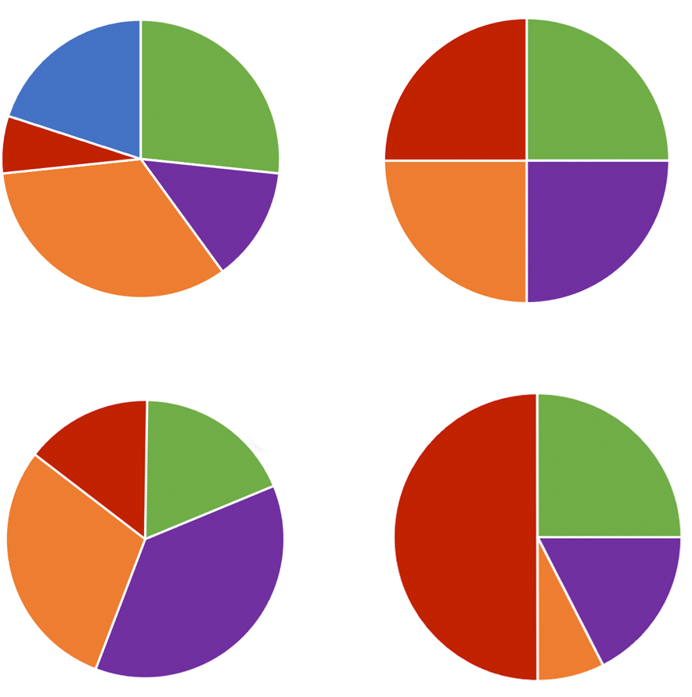
7.2.1 Warm-Up: Which One Doesn’t Belong?
With your partner, review the four circle graphs and determine which one doesn’t belong. Explain your choice.
A.
B.
C.
D.
volume 1, pg. 299

Slide 7

Guided Instruction
volume 1, pg. 300

Slide 8
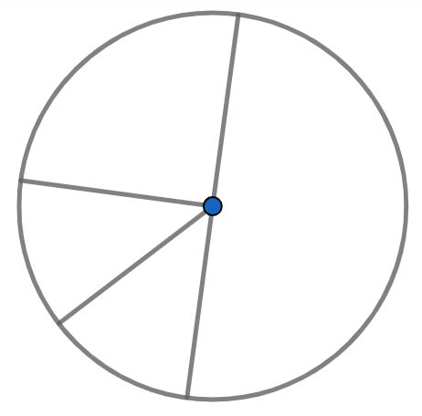
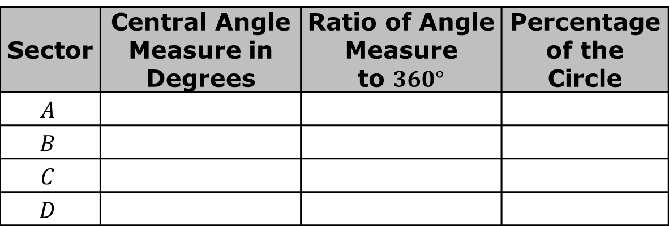
7.2.2 Guided Instruction: Central Angle Measures of Sectors
The circle below is divided into sectors.
Use your protractor to measure the angle for each sector. Then, complete the table.
B
A
C
D
volume 1, pg. 300

Slide 9
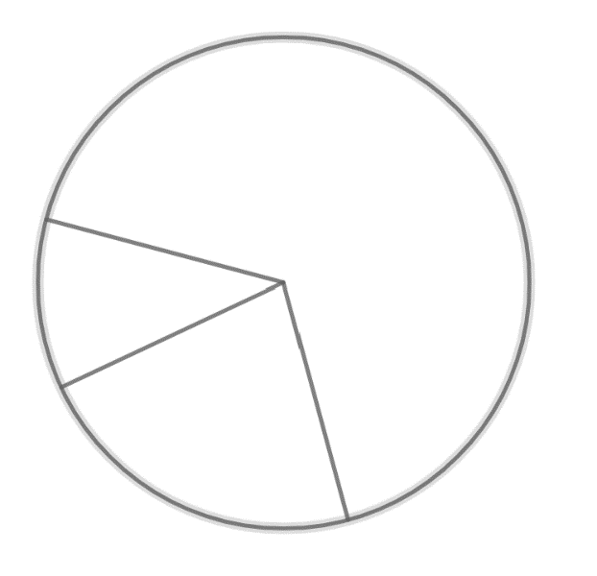
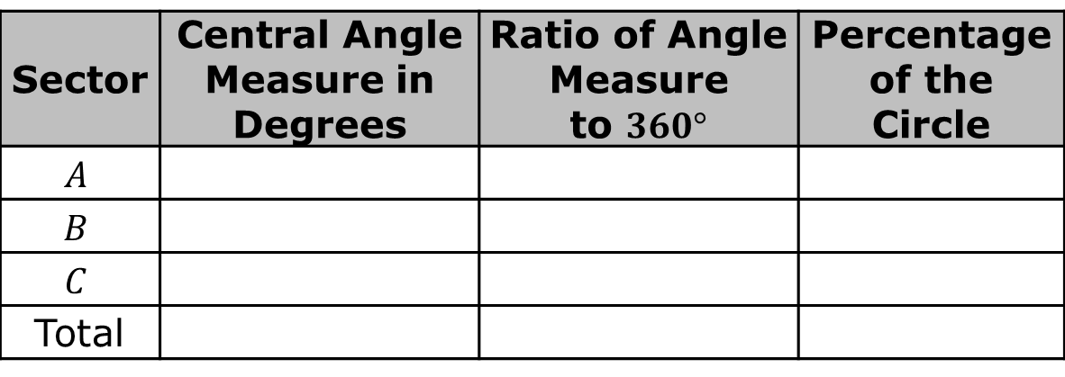
Discuss with your partner how the central angle is related to the percentage of the circle. Summarize your discussion.
A circle with three noncongruent sectors is shown.
Use your protractor to measure the angle for each sector. Then, complete the table. Round your answers to the nearest whole number.
A
C
B
volume 1, pg. 300

Slide 10
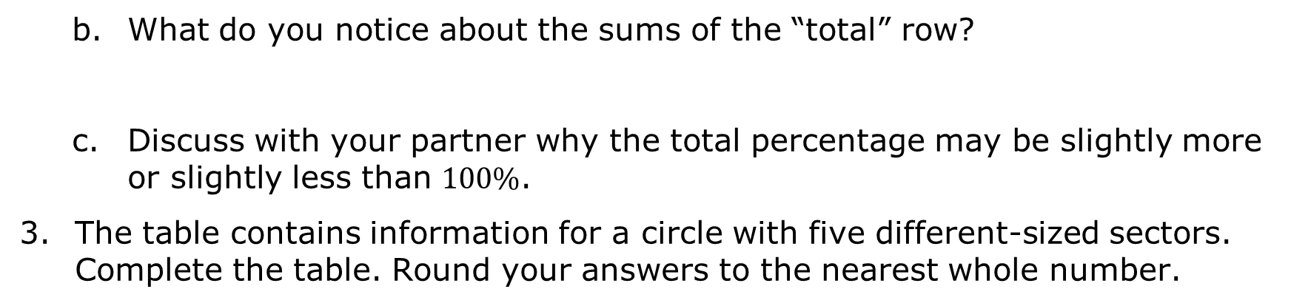
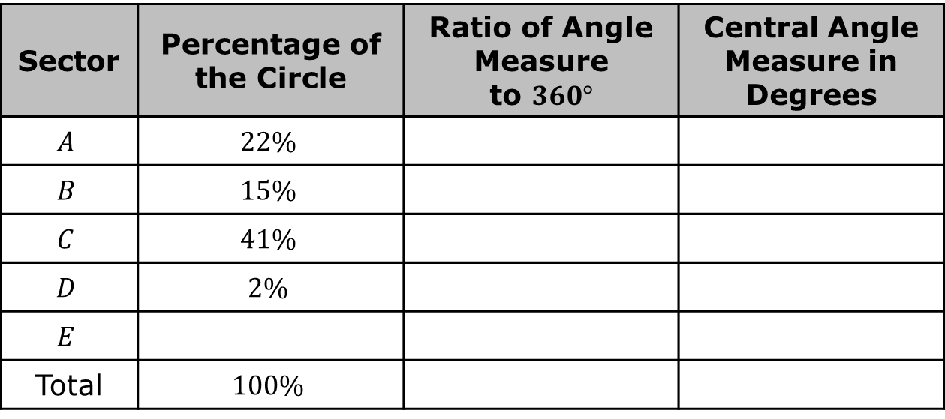
volume 1, pg. 301

Slide 11

Guided Practice
volume 1, pg. 301

Slide 12

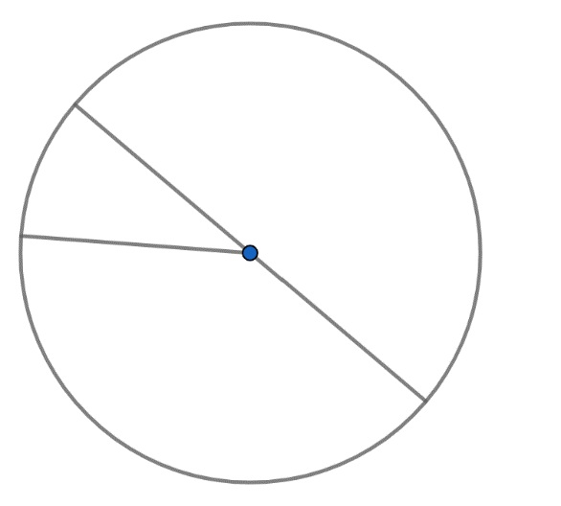
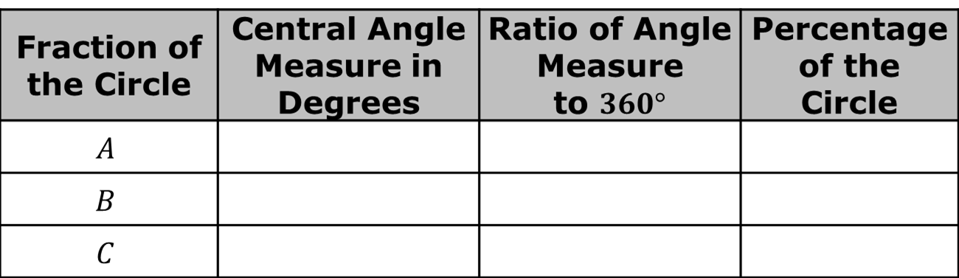
7.2.3 Guided Practice: Central Angle Measures
A circle with three noncongruent sectors is shown. Use your protractor to measure the angle for each sector. Then, complete the table. Round your answers to the nearest whole number.
C
A
B
volume 1, pg. 301

Slide 13
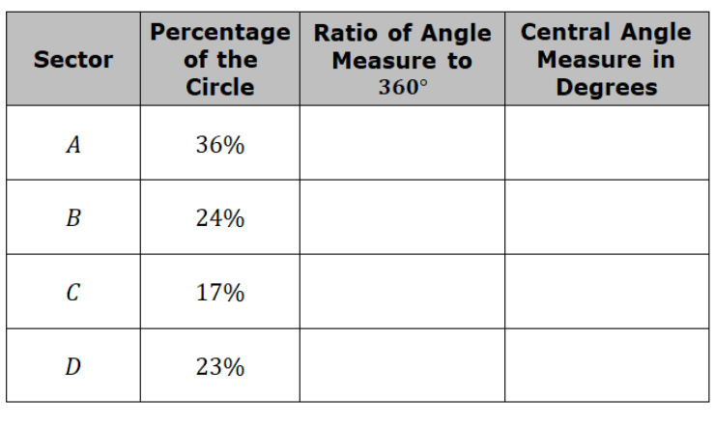
The table contains information for a circle with four different size sectors. Complete the table. Round your answers to the nearest whole number.
volume 1, pg. 302

Slide 14

Wrap-Up
volume 1, pg. 302

Slide 15
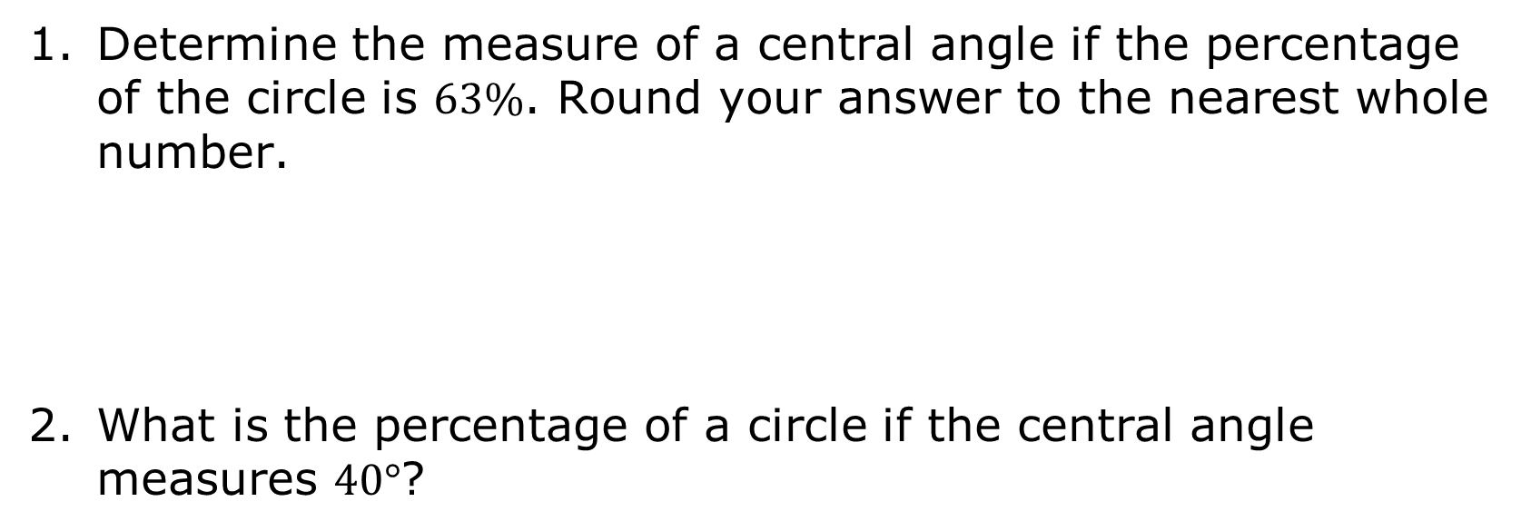
7.2.4 Wrap-Up: Cool Down
volume 1, pg. 302

